Slide 1

Perceptron: Proof of Convergence
Dr. Umarani Jayaraman
Assistant Professor

Slide 2
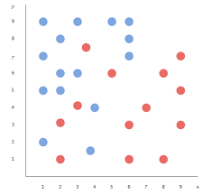
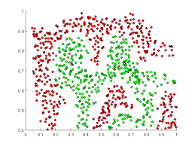
What classifier do you use?

Slide 3
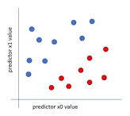
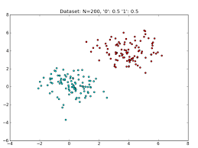
What classifier do you use?

Slide 4
Possible solution for previous problems
K-NN search
Testing: It is time consuming as it should compare the distance with all the sample
This methods works well if the number of samples are less
Linear discriminant function (LDF)
It uses sample to estimate the parameter such as w and w₀
Testing: It just substitute the value of x in g(x) and take the decision
If g(x) > 0 then class 1, otherwise class 2

Slide 5
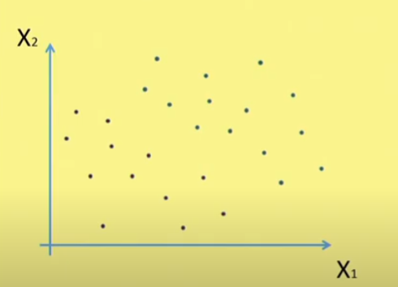
Perceptron: two class problem

Slide 6
Perceptron - two class problem

Slide 7
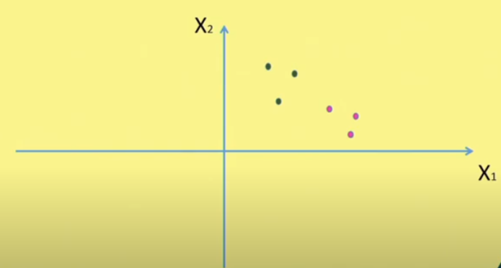
Perceptron -two class problem

Slide 8
Linear Classifier: Perceptron

Slide 9
Linear Classifier: Perceptron
This linear line clearly separates the two classes
Also, we can see there is a limit of orientation of this particular line (decision boundary)

Slide 10
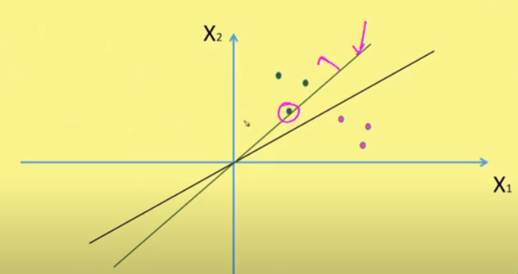
Linear Classifier: Perceptron
If we rotate further in anti-clock wise direction, the misclassified sample is the one marked as circle.

Slide 11
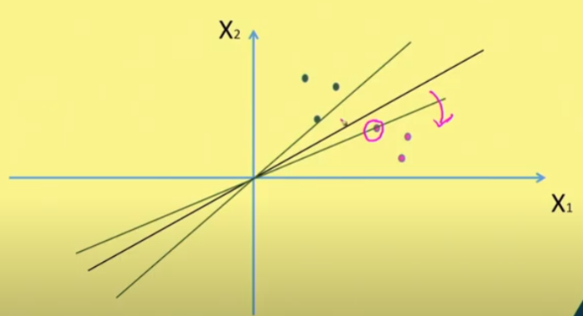
Linear Classifier: Perceptron
Similarly, if we come to the other side, this is the limit
If we rotate it further in clock wise direction; the misclassified sample is shown in circle

Slide 12
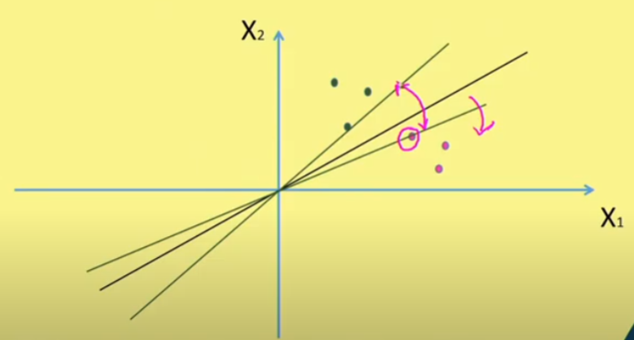
Linear Classifier: Perceptron
So the range, that we could have is shown here.

Slide 13
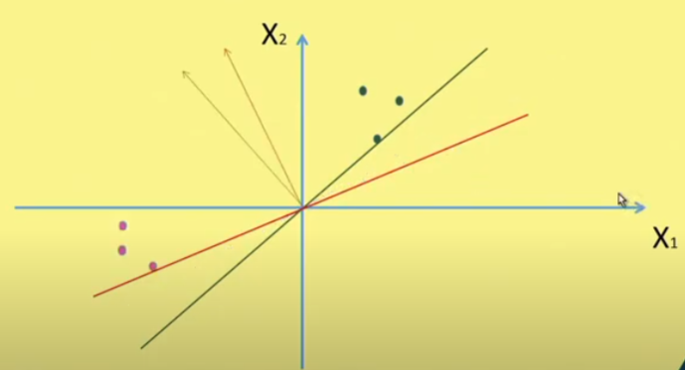
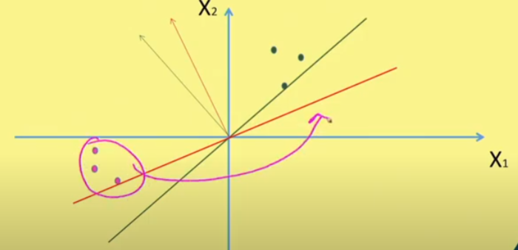
Linear Classifier: Perceptron
After taking negation of all sample for class 2

Slide 14
Linear Classifier: Perceptron

Slide 15
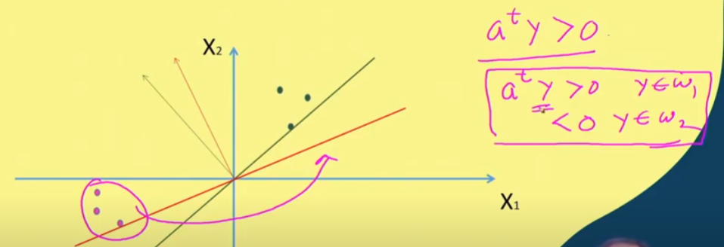
Linear Classifier: Perceptron
For design purpose alone we use a^{t}y>0
For testing we use if a^{t}y>0, then y is class 1
If if a^{t}y<0, then y is class 2

Slide 16
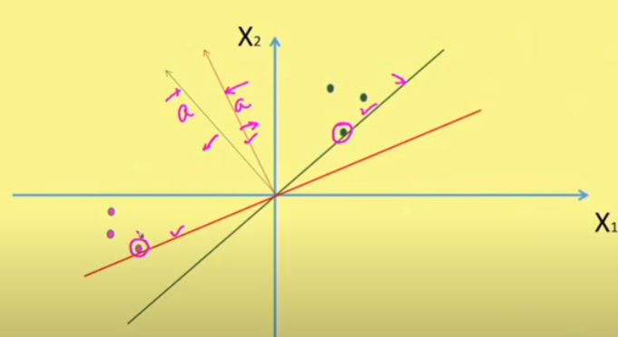
Linear Classifier: Perceptron

Slide 17
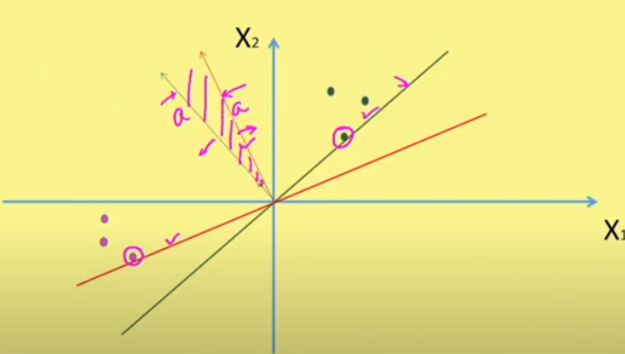
Linear Classifier: Perceptron
So the solution vector ‘a’ must lie on this solution region.

Slide 18
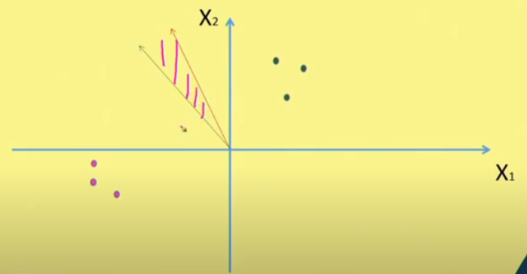
Linear Classifier: Perceptron
How do we make the solution vector ‘a’ should land in solution region?

Slide 19
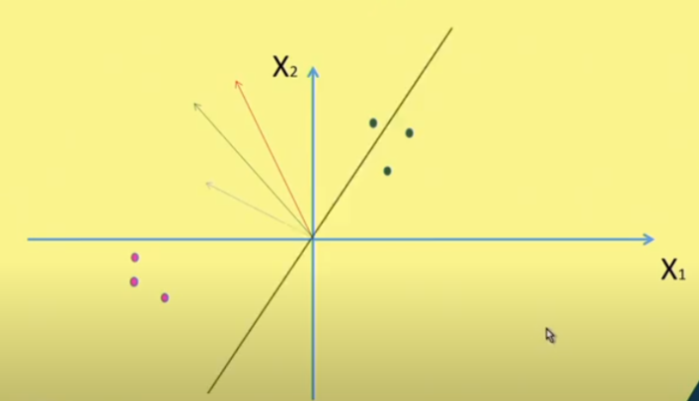
Linear Classifier: Perceptron
Suppose, initial weight vector a(0) is chosen something like this

Slide 20
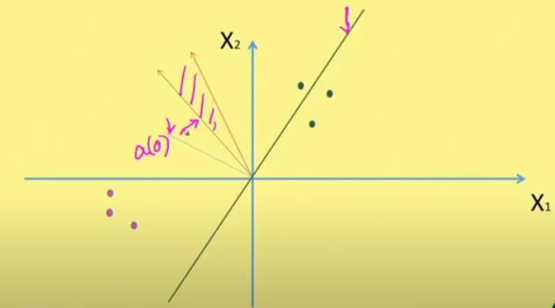
Linear Classifier: Perceptron

Slide 21
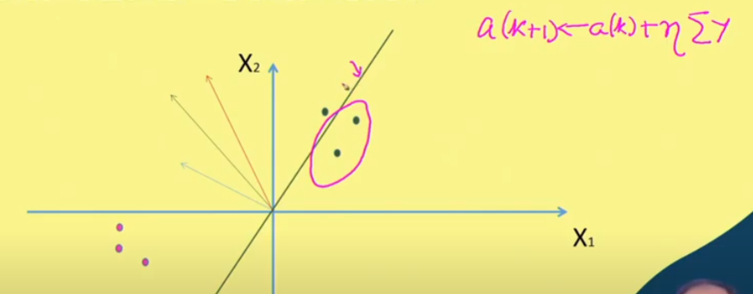
Linear Classifier: Perceptron

Slide 22
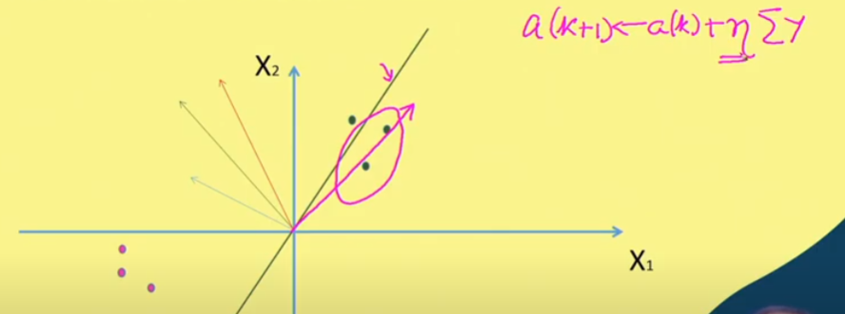
Linear Classifier: Perceptron
All mis-classified samples are in the direction shown

Slide 23
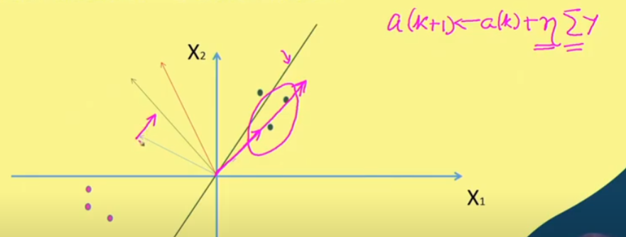
Linear Classifier: Perceptron
So, a(0) is moved in the direction as shown and slowly it land in the solution region.

Slide 24
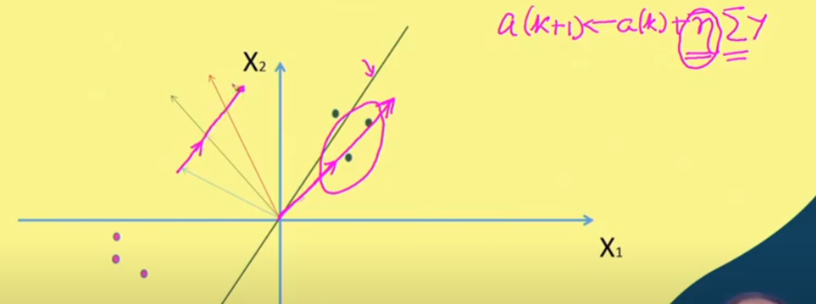
Linear Classifier: Perceptron
If the learning rate η is very large then solution vector is over shooted.

Slide 25
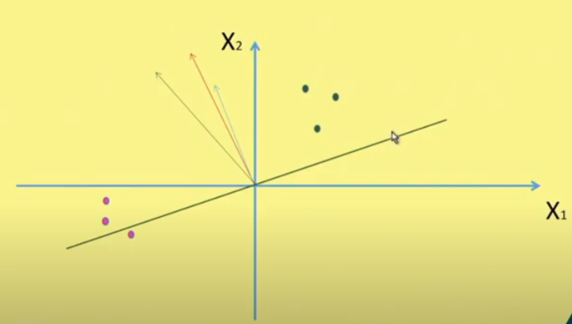
Linear Classifier: Perceptron
If the learning rate η is very large then solution vector is crossed the solution region.

Slide 26
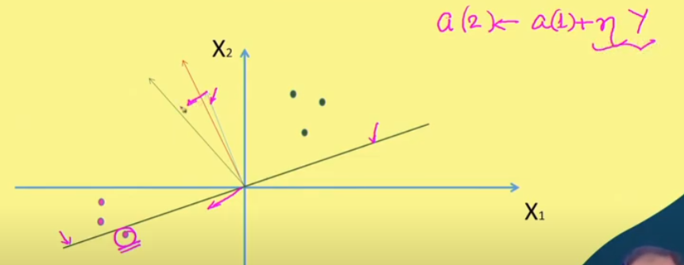
Linear Classifier: Perceptron

Slide 27
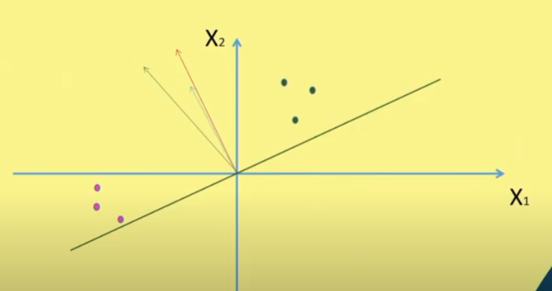
Linear Classifier: Perceptron
This approach clearly says that by taking gradient descent approach it is possible the weight vector converge in the solution region.

Slide 28
Perceptron criteria
The approach can be J(a) =∑ - (a^{T}y)
Using gradient decent algorithm
It works well if the classes are linearly separable

Slide 29
MSE criteria
If the classes are linearly separable, then it is possible to have linear decision boundary like this
If the classes are not linearly separable then the approach is based on minimum error criteria (Mean Square Error criteria)

Slide 30
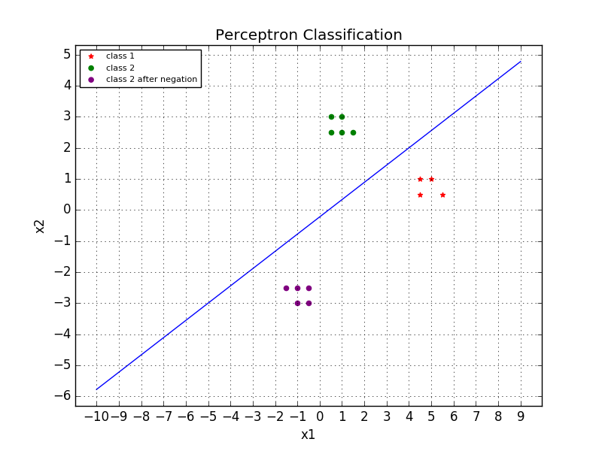
Linear Classifier: Perceptron

Slide 31
Summary
Convergence Procedure of Perceptron Algorithm

Slide 32
Thank you

